Slide 1
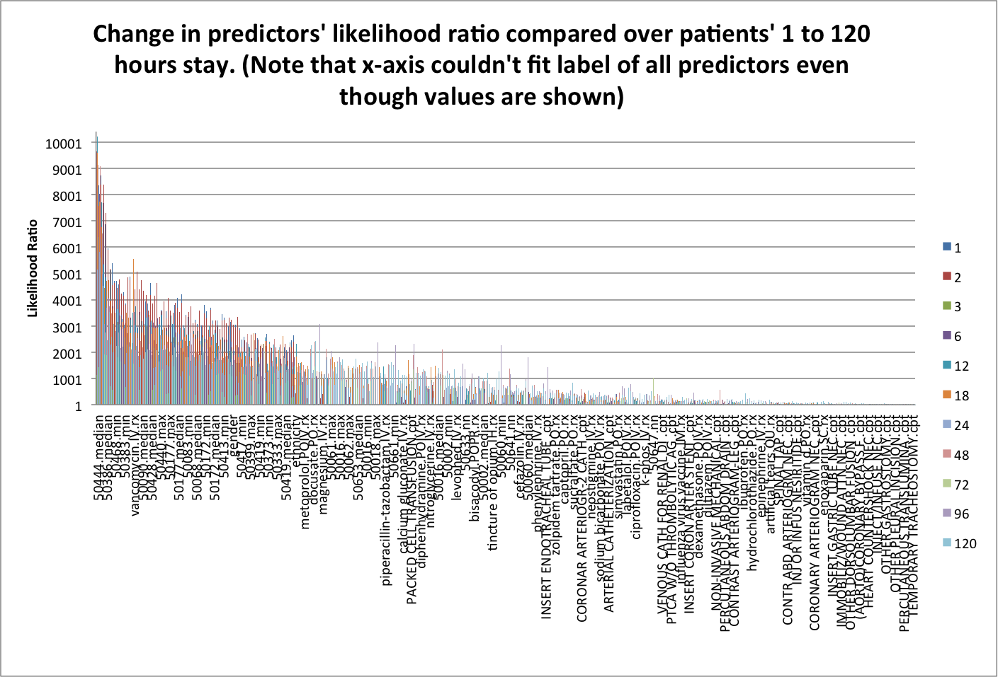
Notice there are stand-alone peaks
depending on which first n hours.

Slide 2
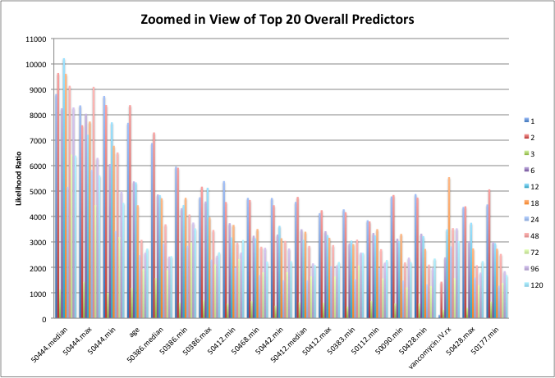
Vancomycin has a peak in the first 18 hours
50444 is consistently a top predictor

Slide 3
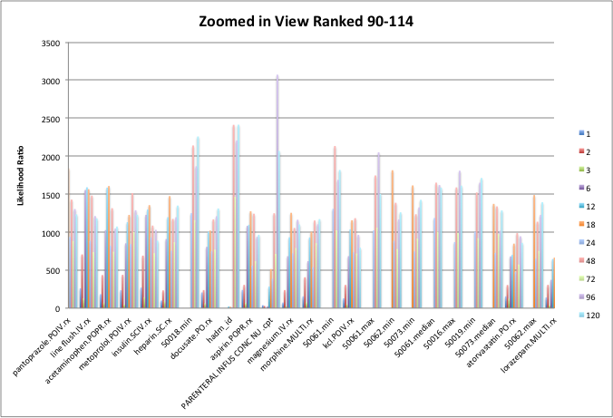
Parenteral Infus Conc Nu has a peak at first 96 hours

Slide 4
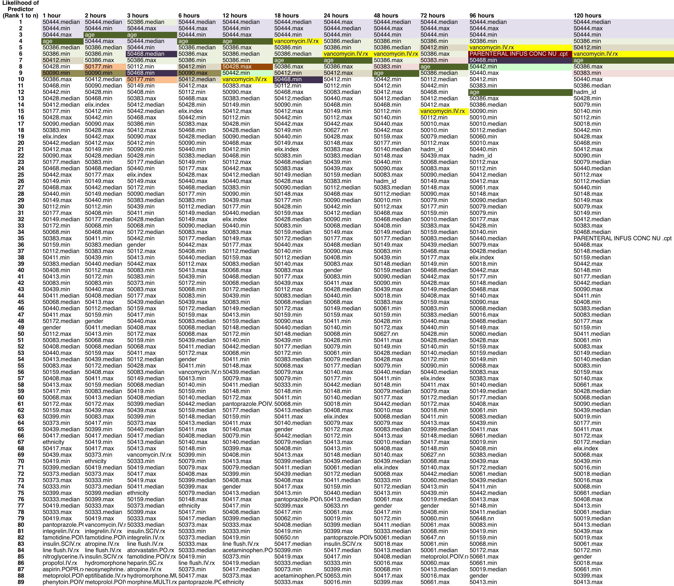
Ranking of predictors

Slide 5
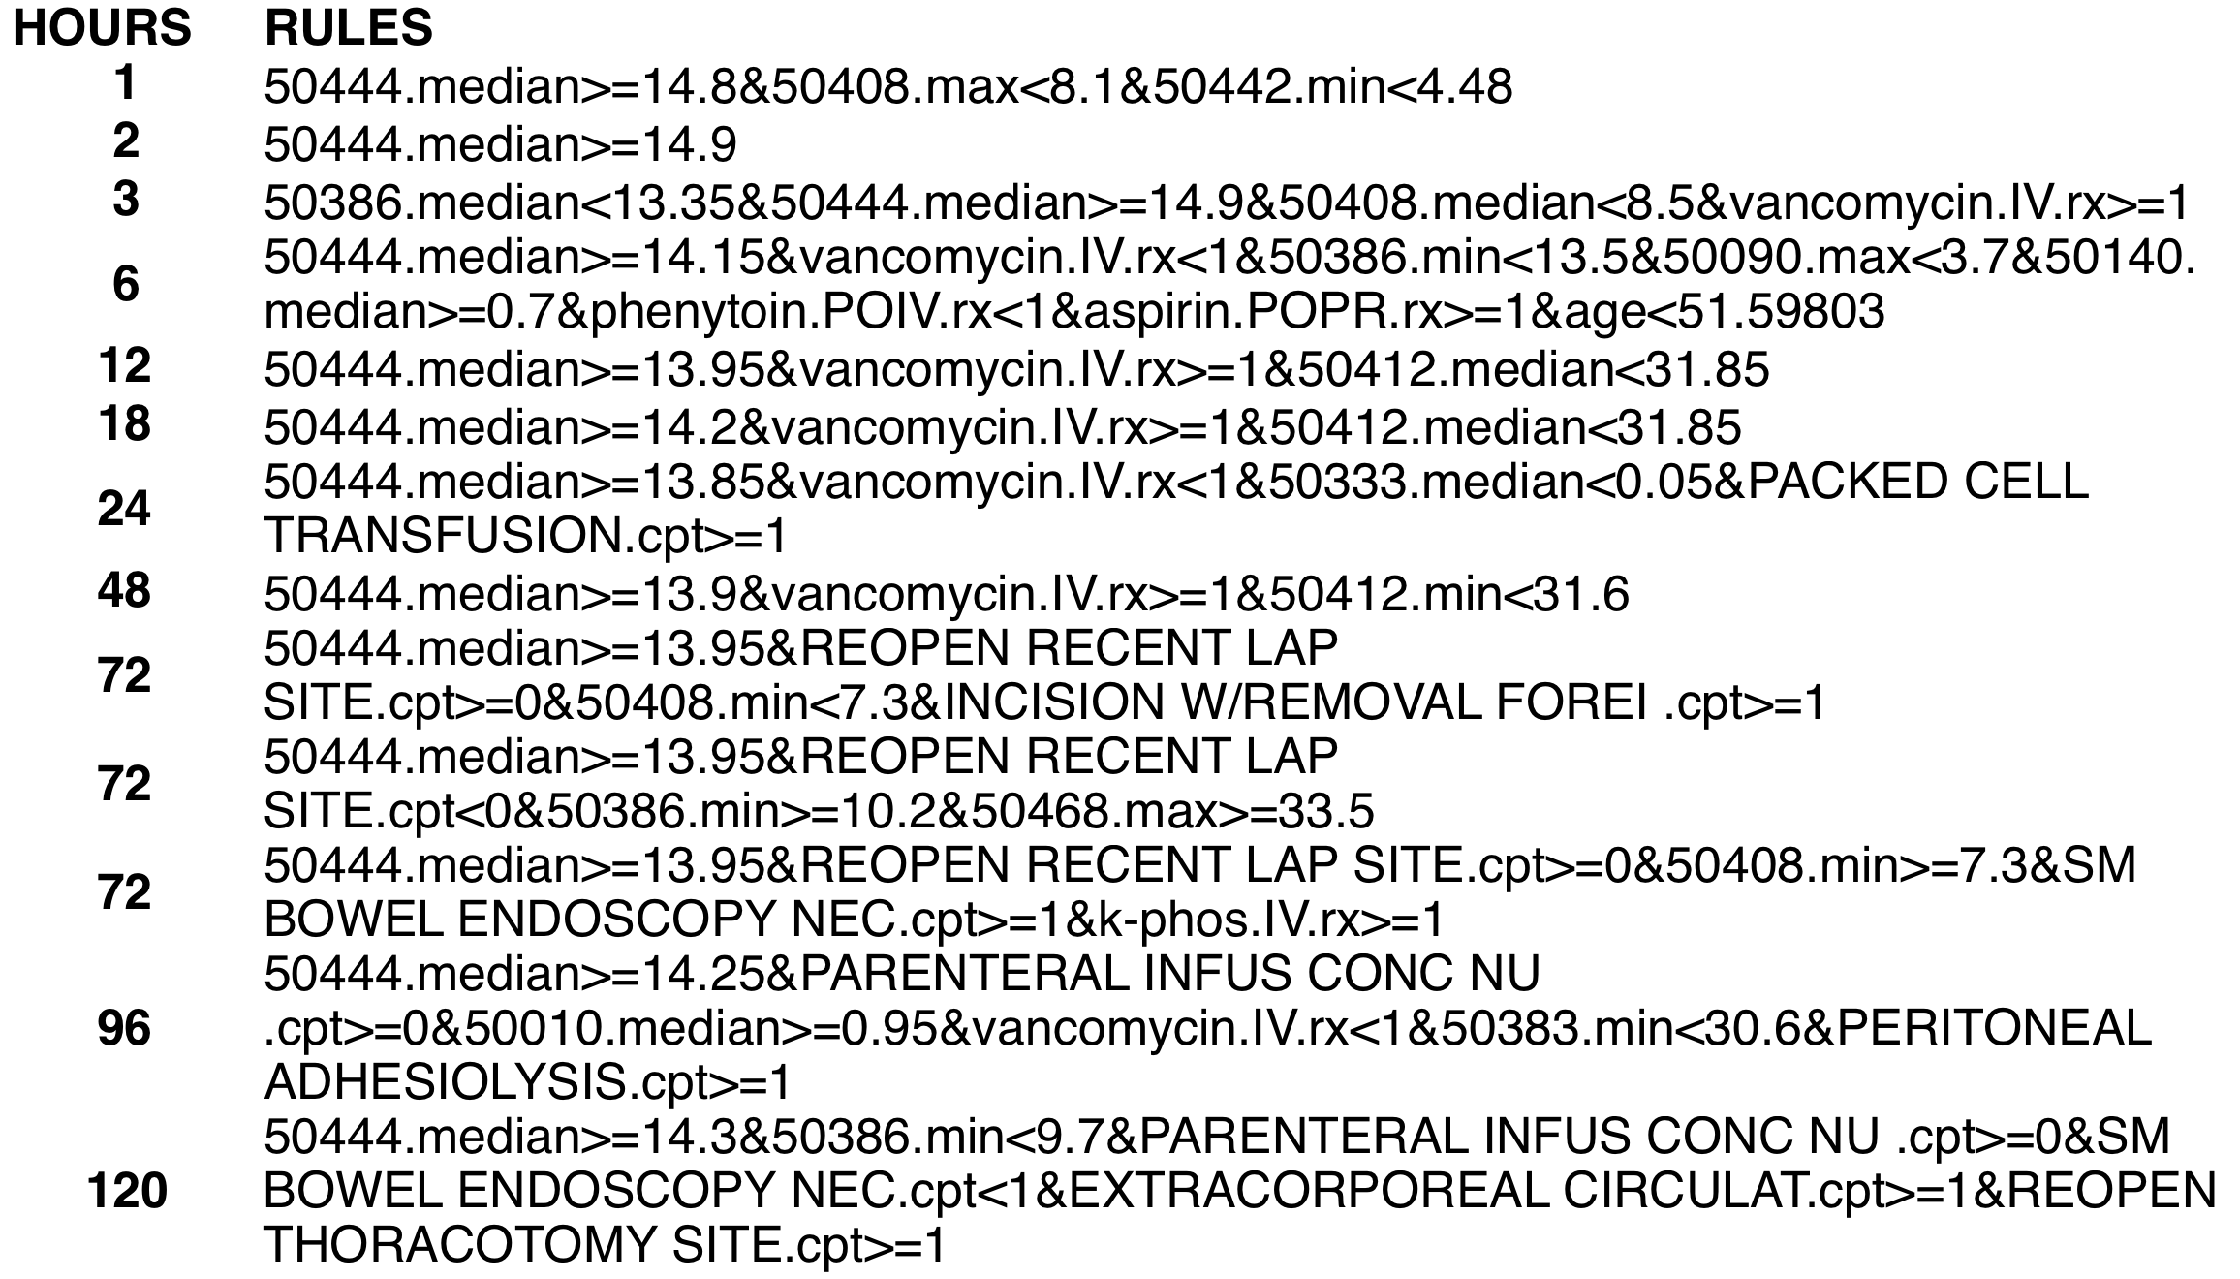
Tree generated rules

